Slide 1
Teen Advocacy Fellows Program
May 2026

Slide 2
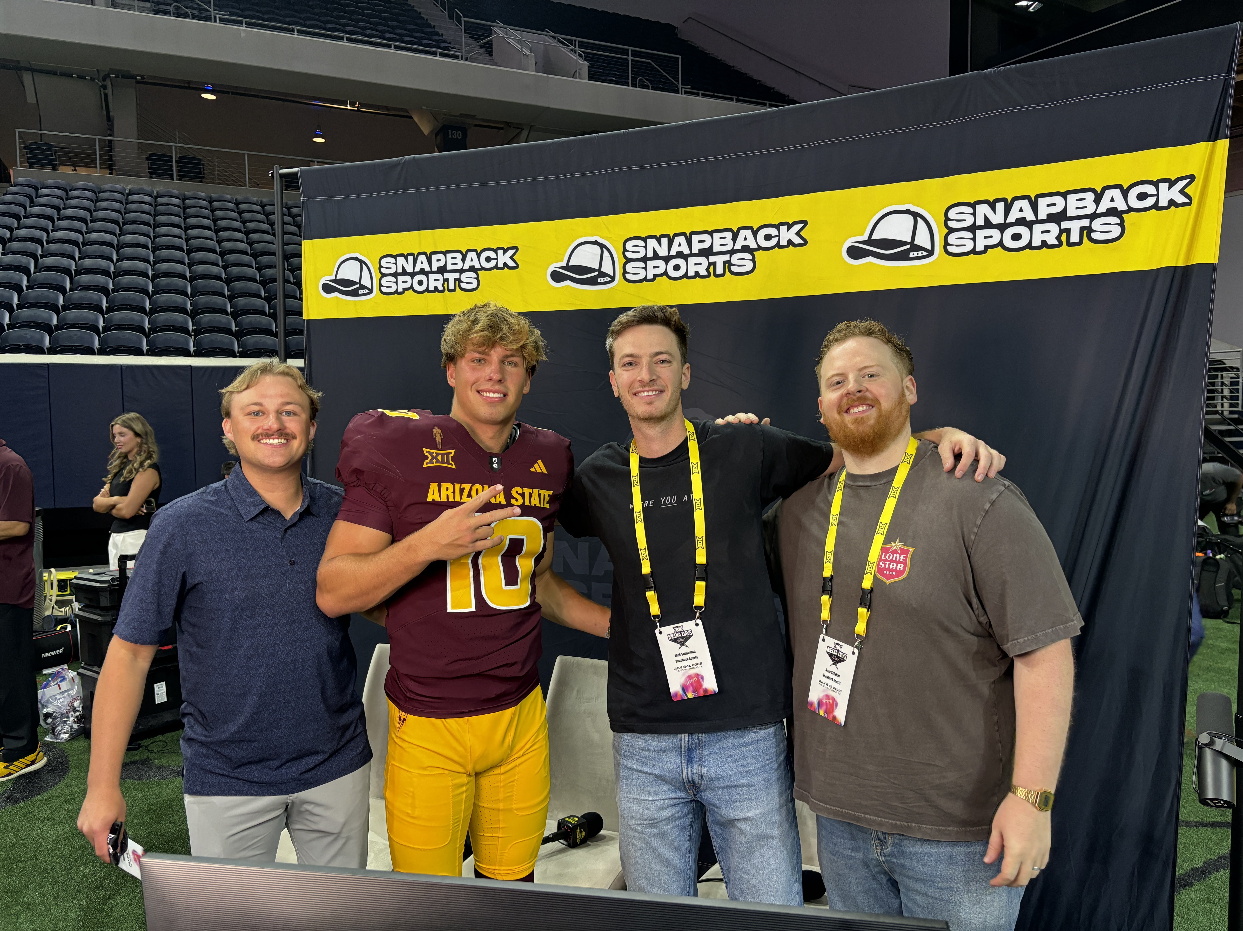
Guest Speaker: Jack Settleman

Slide 3
Fellow Feature Format
Time limit: 2 minutes
Name, age, hometown/state, and grade
Question:
What’s one thing you’re surprisingly good at?

Slide 4
Drawn to Action
Update

Slide 5
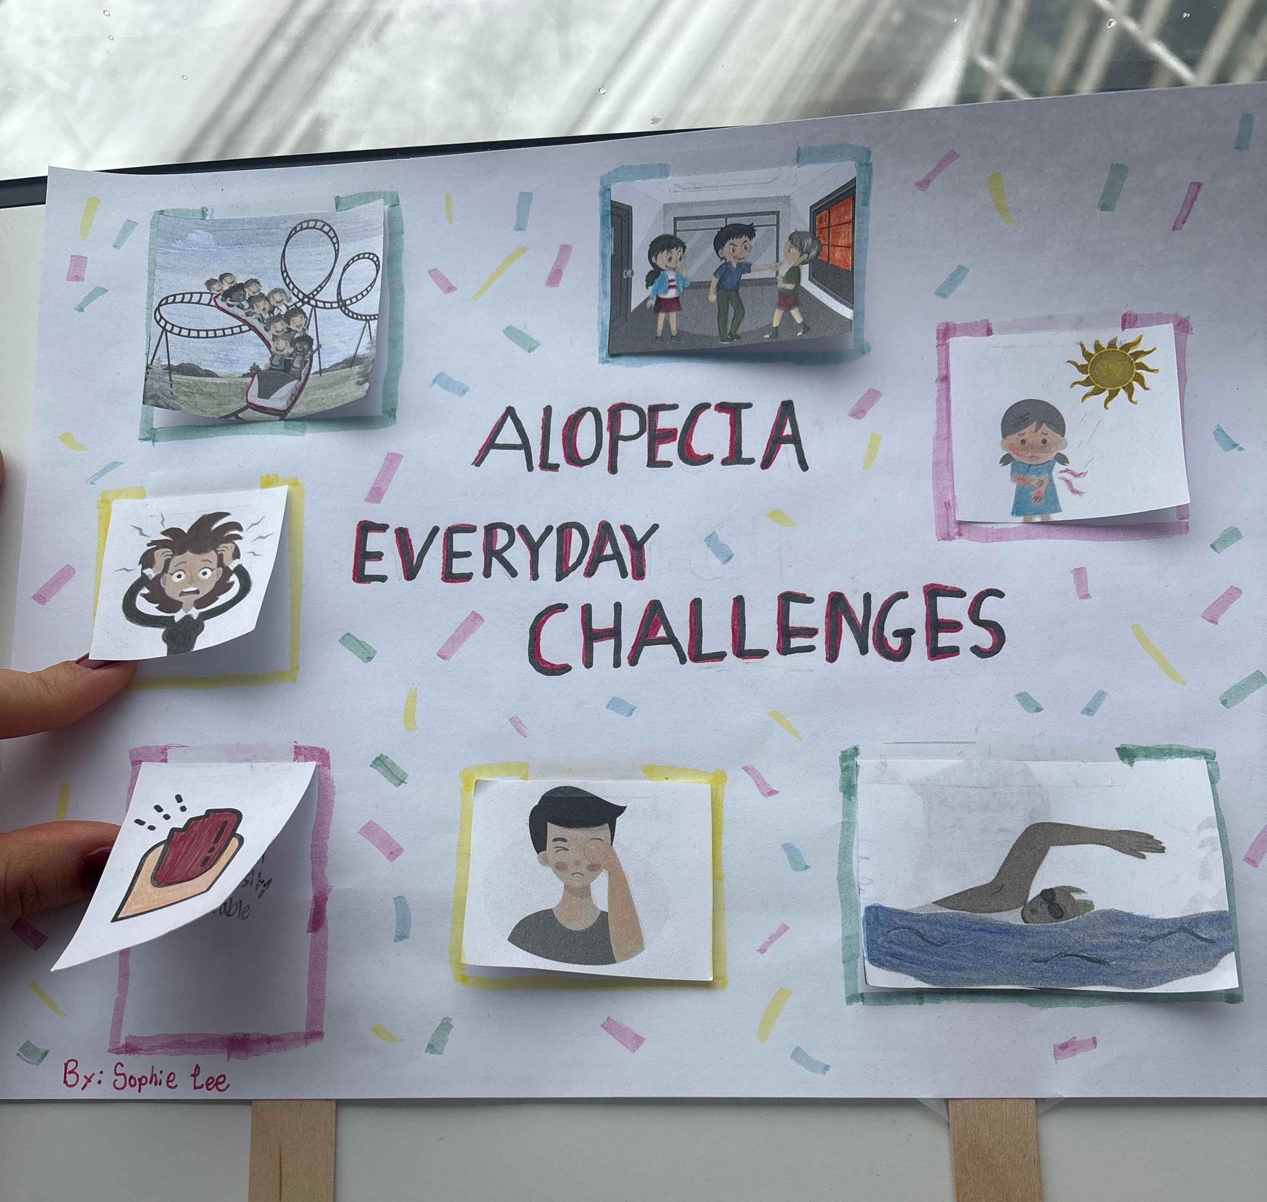

Slide 6
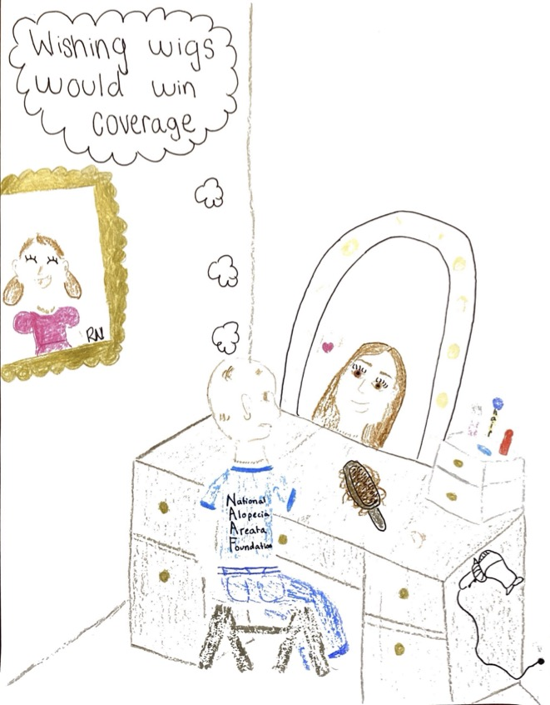

Slide 7
Storytelling Practice

Slide 8
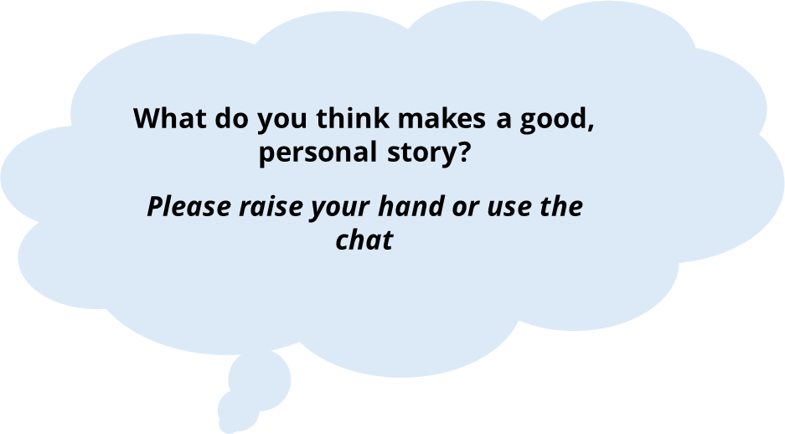

Slide 9
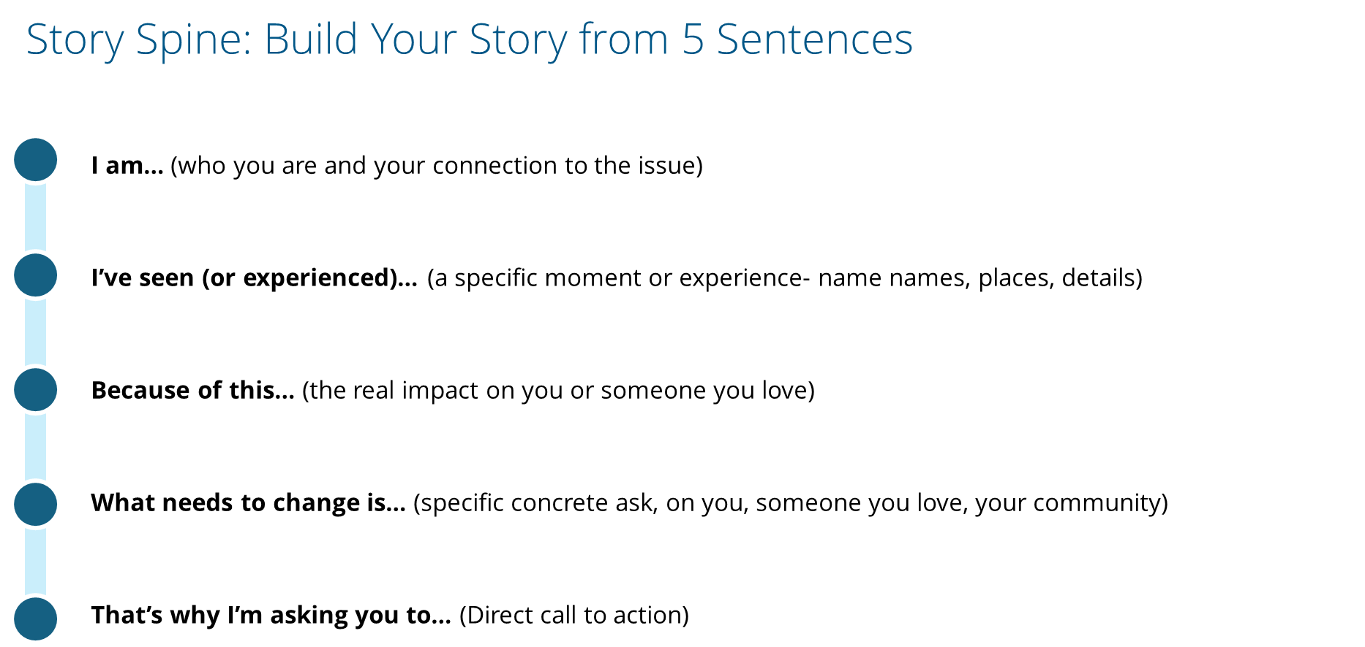

Slide 10
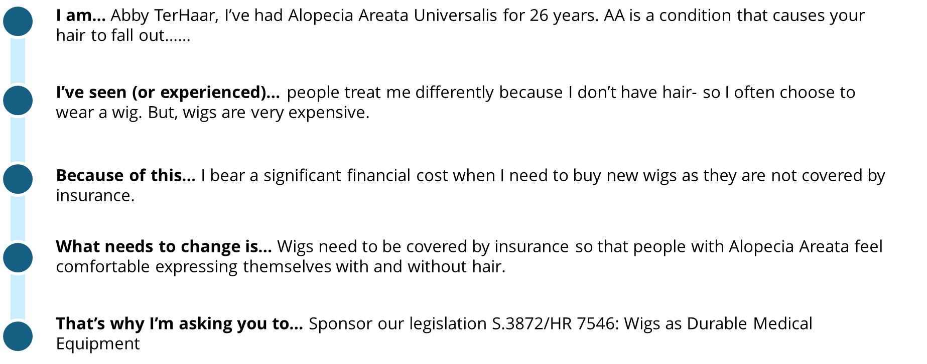

Slide 11
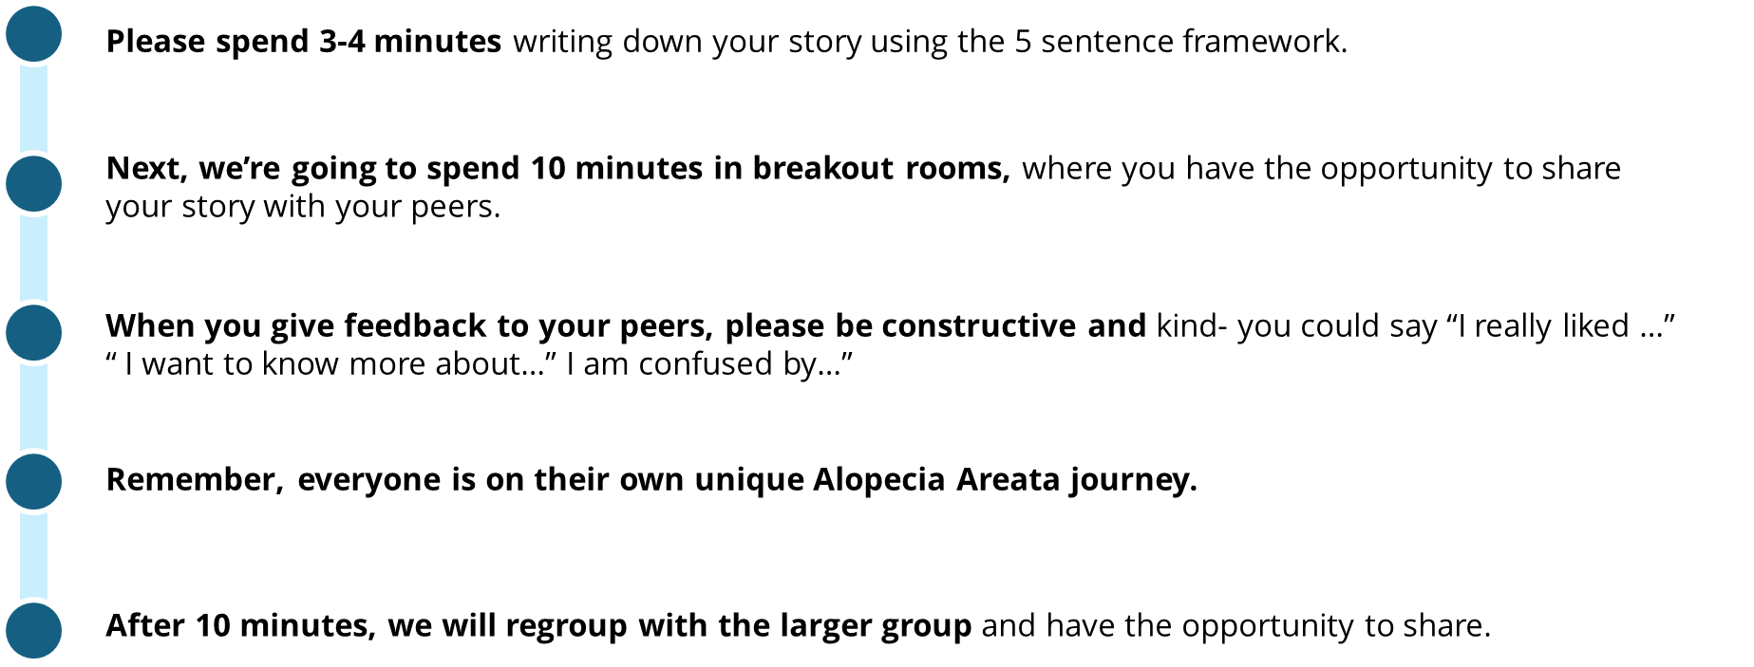

Slide 12
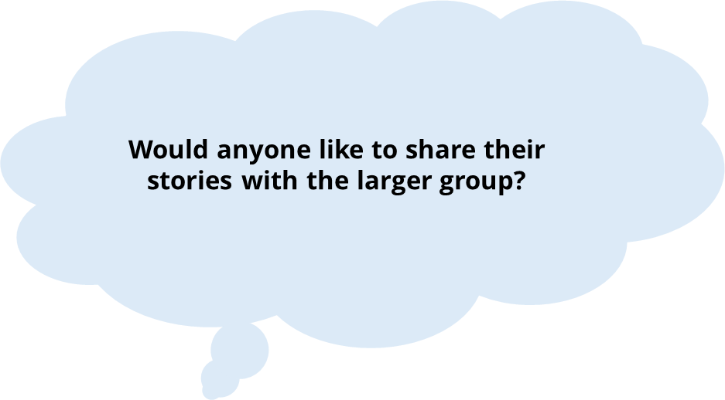

Slide 13
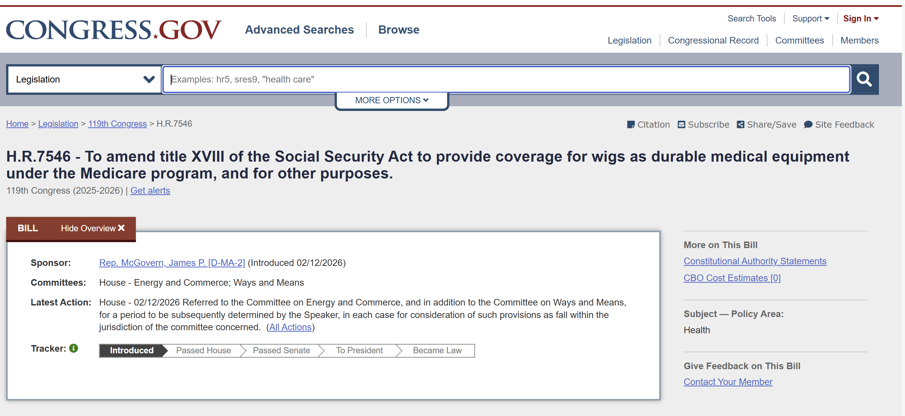
Medical Wig Legislation: Update
https://www.congress.gov/bill/119th-congress/house-bill/7546

Slide 14
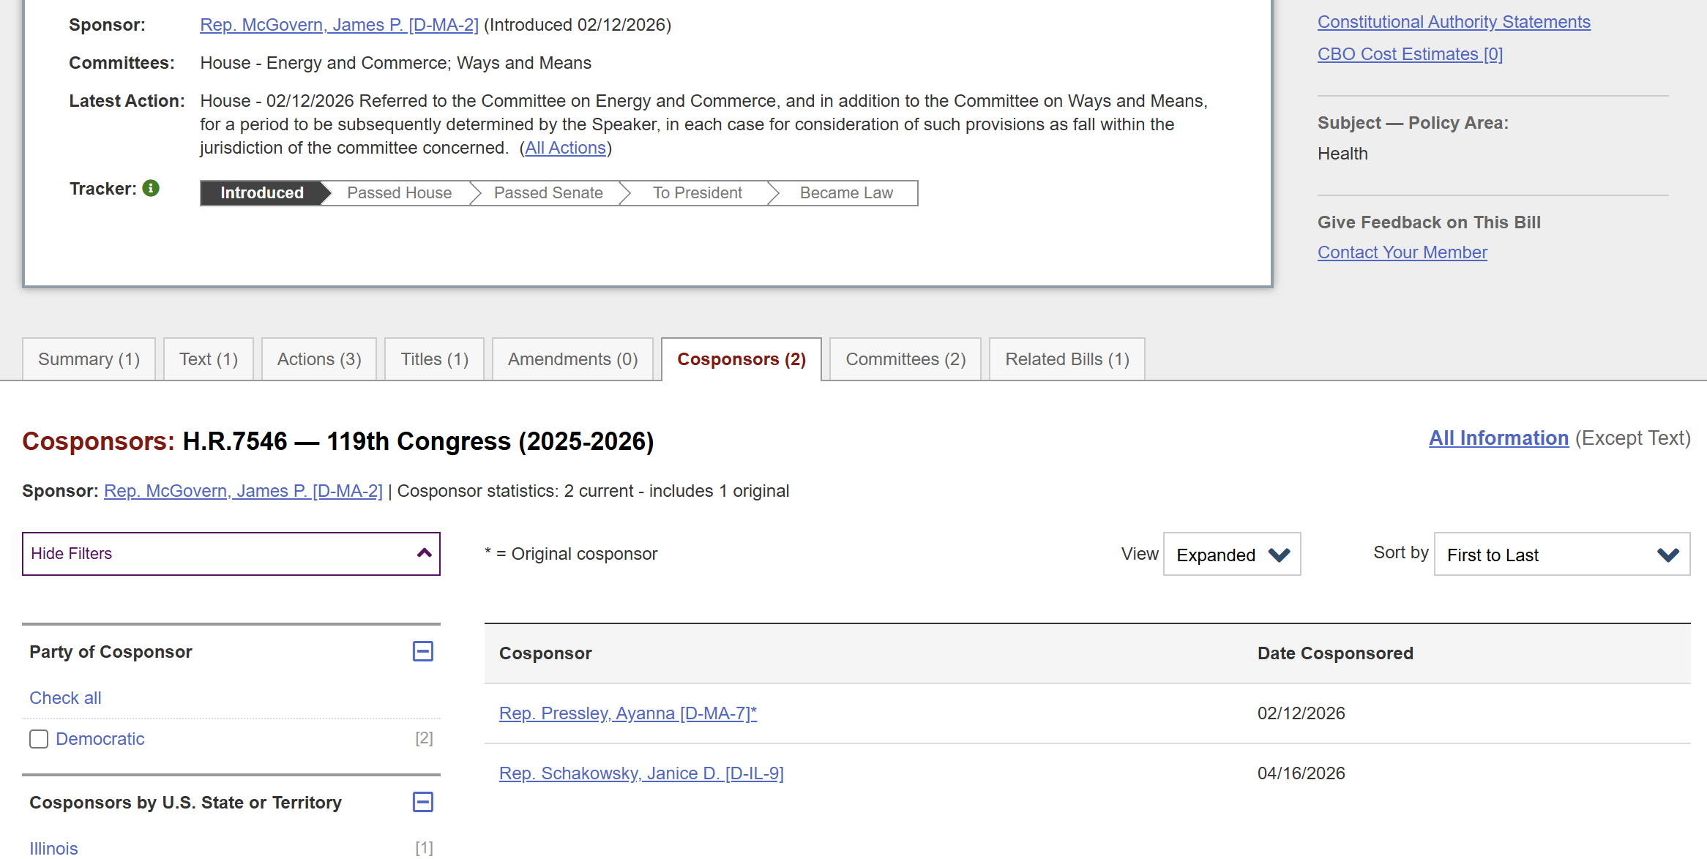
Medical Wig Legislation: Update
https://www.congress.gov/bill/119th-congress/house-bill/7546

Slide 15
Campaign Management
Review the legislator(s) for whom you are responsible for setting up meetings. Information on the TAF Resource page (PW: T@Fr0cks!):
  "2026 Legislator Meeting Assignments" spreadsheet
  Note if we’re recommending scheduling a virtual meeting and how many people you should plan to attend your meeting (each Fellow in the state/district plus one parent)
  Each TAF will schedule 1-3 legislator meetings; each TAF should have the opportunity to attend 3 meetings

Slide 16
Campaign Management
Review the steps in the “How to Schedule A Meeting” one-pager, also posted on the TAF Resource page
  This one-pager includes links to find the contact information for both Representatives and Senators

Slide 17
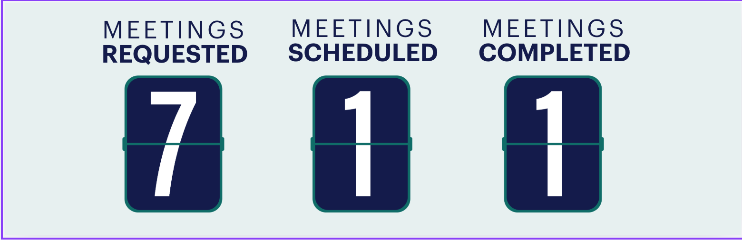
Campaign Progress Report
Meeting tracking form is located here.

Slide 18
Upcoming Recesses
May: Memorial Day
  House: May 22 – June 1
  Senate: May 23 – May 31
June
  House: June 12 – 22
July 4th
  House: July 3 – 12
  Senate: June 27 – July 12
Most weekends are also good meeting opportunities!

Slide 19
Meeting Scheduling Review & Questions

Slide 20
Handling Legislator Pushback

Slide 21
Expect Disagreement
“Can we quantify the impact of this coverage on both the public- and private-sector markets?”
“This is ripe for fraud!”
“This is not my issue area”
“We already spend too much money”
“This will never pass as a standalone bill”

Slide 22
Lots of Reasons for Disagreement
Political agendas
Policy/precedent concerns
Management of priority issues/constituent needs
Bad day
Some legislators won’t agree. That’s OK!

Slide 23
Stay Focused on Message & Story
If we have a message point with which to respond
  This is ripe for fraud!
  Use message point: “Requiring a doctor's certification and oversight by CMS creates guards against misuse”
If we don’t have a message point
  Is it a specific policy question?
    ”Can we quantify…”
    Say “I don’t know” and refer to NAAF for follow-up

Slide 24
Stay Focused on Message & Story
If we don’t have a message point
  Is it a general statement?
    Does it relate to the bill’s topics?
      ”We already spend too much money”
        Tell your story. “I understand. Let me tell you why this is important to me…”; and/or
        Thank the member for their feedback

Slide 25
Stay Focused on Message & Story
If we don’t have a message point
  Is it a general statement?
    Is it unrelated to the bill’s topics?
      ”This is not my issue area”
        Ask if NAAF team can provide more background
      “This will never pass as a standalone bill”
        Thank the member for their feedback

Slide 26
Stay Focused on Message & Story
Always focus on our message and your story
  If conversation drifts, find the opportunity to pivot back
And: Always report legislator feedback to NAAF!

Slide 27
Admin
Upcoming meeting schedule
  NO meeting in June
  Next meeting scheduled for: Thursday, July 9, at 7pm EDT/4pm PDT
Help and feedback will be available as you get started!
  Email Abby and/or Julie
  Office hours with Abby: May 19 8:15 PM EDT/5:15 PM PDT
All campaign info is available on the Resources page: https://www.naaf.org/naaf-teen-advocacy-fellows-resources/
  PW: T@Fr0cks!
  Campaign Status toteboard will be added soon

Slide 28
Action: Join TAF WhatsApp Group
Goal: Have real-time campaign conversation
  Share ideas
  Ask questions
  Share meeting photos
Abby and NAAF team will participate
User agreement coming via email
  Parent and Fellow must sign

