Slide 1
Using the 2026
Meeting Tracking Form

Slide 2
1st Thing: One Form for Each Legislator
We will track activity for each meeting; so:
You will need to complete a form for EACH legislator for whom you are coordinating a meeting

Slide 3
2nd Thing:
3 Submissions for Each Legislator’s Form
First submission:
Meeting is requested
Notes:
For the vast majority of meetings!
In a few cases legislator responses (or lack thereof) may dictate more form submissions. Will cover this later in presentation.

Slide 4
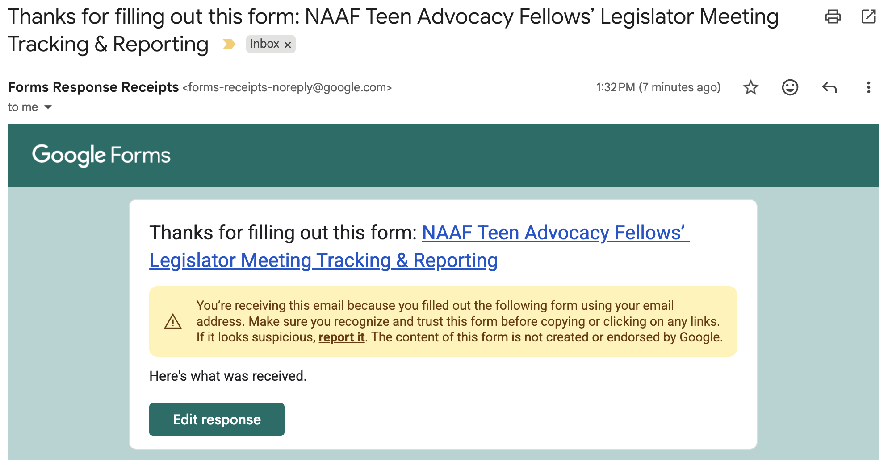

Slide 5
2nd Thing: 3 Submissions
Second submission:
Meeting gets scheduled

Slide 7
Second Email to Your Inbox

Slide 8
2nd Thing: 3 Submissions
Third submission:
Meeting gets completed

Slide 9
Return to Second Email

Slide 10
Third and Final Email to Your Inbox

Slide 11
Admin
Other meeting statuses:
  No response
    Use link in email received after request is made
    Consider using if you don’t hear anything back on meeting scheduling after about 8 weeks
  Cancelled
    Use only if a scheduled meeting is removed from the calendar with no new date provided
NAAF team will follow up based on form responses
Help and feedback will be available
  Email Abby, Julie, or Mike (mike@relateadvocacy.com)
Notes:
There may be a few instances where you have more than 3 form submissions: “no response” or “cancelled.”
NAAF team will respond based on “help” question and status changing to “scheduled,” “completed,” or “no response.”

