Slide 1
Congress 101
Notes:
We’re going to start by talking about the people. process, and politics that decide how ideas—like insurance coverage for wigs—become laws.

Slide 2
Why do Congress’s decisions matter to you?
Notes:
Provide your answer in the chat.

Slide 3
Poll:
How many times have you learned about how a bill becomes a law?
Notes:
Flash Zoom poll on-screen
5, 3-4, 1-2, first time for everything

Slide 4
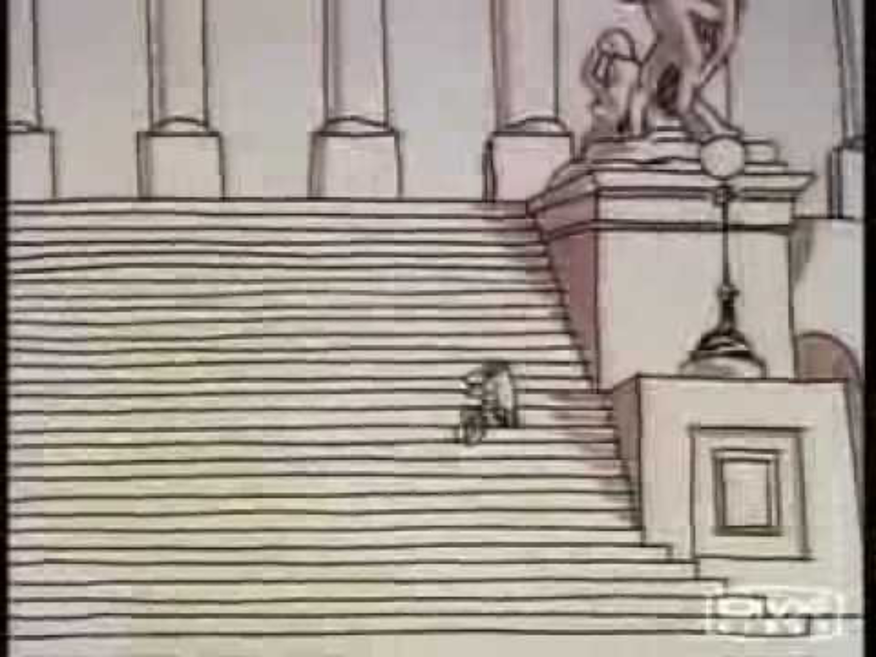

Slide 5
Let’s Review That Process Again
A problem is identified…in our case by NAAF and its volunteers
We educate a Representative(s) about the problem
Representative introduces a bill
Notes:
Who’s had the opportunity to talk with/educate a legislator on an alopecia issue?

Slide 6
Process Review, Part 2
A House committee reviews the bill and votes on it
If the bill passes the committee, it could move to a vote by the full House
This same process must happen in the Senate

Slide 7
Process Review, Part 3
House and Senate bills must be identical
Identical bill passed by the House and Senate goes to the President, who can sign or veto it
Vetoes can be overridden by 2/3s majority in each chamber
Notes:
If bills aren’t identical, a conference committee is needed!

Slide 8
Passing a Bill is Hard!
Only 1.7% of bills introduced were passed during 118th Congress
Committees don’t need to hear bills; if a bill passes a committee, it doesn’t have to get a vote by the full chamber
Getting bill cosponsors helps build momentum!
Notes:
Congressional terms are two years. 118th Congress is the last full Congress; ended in early January 2025.
Passing bills is very difficult! In 118th: 274 bills passed total

Slide 9
Myth or Fact:
Because each member of Congress has a vote, each member is equally important to passing a bill.
Notes:
Flash Zoom question on-screen
Myth. 535 voting members (435 in House and 100 in Senate) are not equally important. Committee Chairs and party leaders, especially those in the majority party, are more important. These members can control what bills get debated and voted on.

Slide 10
Leadership Drives Action
Majority party in each chamber controls debate
Leaders in majority party are most powerful
  House: Speaker and Majority Leader
  Senate: Majority Leader
  Committee Chairs
Exception: Individual senator can “filibuster” a bill
  60 votes needed to end debate
Notes:
Leaders are concerned with what the members of their party are concerned about!
We don’t ignore minority party…they’ll be in the majority again someday

Slide 11
Quiz:
What happens to bills that Congress doesn’t vote on?
Notes:
Flash Zoom question on-screen
They remain in a queue until voted on
If they aren’t voted on by the end of a Congress, they die
If they aren’t voted on within 90 days of introduction, they die

Slide 12

Reality for most members

Slide 13
They’re Overwhelmed!
They have a lot to manage:
  Average House district = 750,000 people
  Over 16,500 bills introduced in 118th Congress
Non-experts on most issues
  Members focus on issues relevant to their committees
  Most have no medical training
Notes:
Who’s had the experience of meeting with their representative or senator? What was it like? What did you learn from the experience?
Medically-focused members:
20 physicians and 4 nurses
2 physicists and 2 chemists
How do they get educated on issues they don’t understand?
Colleagues
Lobbyists
And…YOU!

Slide 14
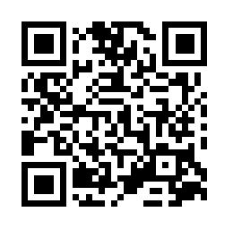
Find your legislators at:
Notes:
We have also added your senators and representative to our Fellows roster

Slide 15

This Reality Requires Advocacy to Earn Attention
Notes:
The main takeaways from this presentation!
Your advocacy is important because:
Legislators need to understand issues
Passing a bill is hard

Slide 16
Advocacy is Needed at Each Step
Educating legislators on issues
Motivating bill sponsors
Recruiting bill co-sponsors
Earning votes in committees and in the full chamber
Urging presidential action
Notes:
Legislators must know that constituents are paying attention to the issue. They must equate your issue with votes!
NAAF’s advocacy strategy is build trusting relationships with legislators. Over time, NAAF earns legislators’ support to make these steps easier.
NAAF will mobilize advocates at each of these steps. It could be via emails, phone calls, meetings, etc., depending on the situation.

Slide 17
Questions?

