Slide 1
Fellow Feature Format
Time limit: 2 minutes
Name, age, hometown/state, and grade
Question:
If you had a free day tomorrow, how would you spend it? Why?
Notes:
Thank you for volunteering. We plan to do these each month and would like to feature all of our fellows by the end of the Program.

Slide 2
Campaign Timeline
January - March
  Learn the ropes
    You will learn about our issue, your audience, and how to schedule meetings
March - December
  Meeting scheduling and execution
  Goal: 68 meetings with Senators and Representatives
Meetings held or scheduled by Dec. 31 will count toward goal
Notes:
We will always make sure you have the information and resources you need to complete your activities.
We will always be available both during meetings and in-between to answer questions and provide feedback and help

Slide 3
Meeting Scheduling Process
Request
Prepare
Execute
Follow-up
Notes:
Here’s a preview of our work. Meetings take time and effort. We’ll delve into the details of this process during our February meeting.
Request
Verbal and written
Be specific
Be persistent with follow-up
Prepare
The most important message is your story
Know the issue(s)
Review NAAF talking points
Be ready for a quick change
Execute
Arrive early
Stay on message
If you don’t have an answer…don’t worry!
Make your ask…if there’s not an urgent issue, ask to touch base and keep the office informed on behavioral health issues
Provide leave behind and content piece, if applicable
Get a picture
Follow-up
Personal thank-yous to member and staff
Provide any follow-up information
Report back to NAAF staff
Post your picture on social and tag the legislator

Slide 4
How We’ll Communicate
Group meetings
  There will be at least 6 this year
Resources and reporting
  TAF SharePoint site
Notes:
SharePoint will have all of the relevant documents, trainings, and background information. If you need the information, it’ll be there.

Slide 5
Content Challenge (optional)
Create a visual piece for your legislator meetings that answers the question:
What should legislators remember about issues important to the alopecia areata community?
Notes:
As we discussed during our welcome meeting in December.

Slide 6
Challenge
Rules and Rewards
Notes:
We have a one-pager that will summarize all of this information:
Rules:
Discuss your idea with Abby and Julie before you begin
Must-haves:
Must be able to bring your piece to a meeting or share online
You can choose format, including pictures, video, drawings, etc.
Content should be appropriate for policymakers
Cannot include inappropriate or offensive language, imagery, or photos
Rewards:
NAAF will include your piece in a content library to inspire future Fellows and share in marketing materials (as possible)
Fellows will be asked to vote on the most creative content piece
2 winners receive $50 gift card; one under 15 and one 15 and older
You will receive special recognition from NAAF at the end of the Fellowship

Slide 7
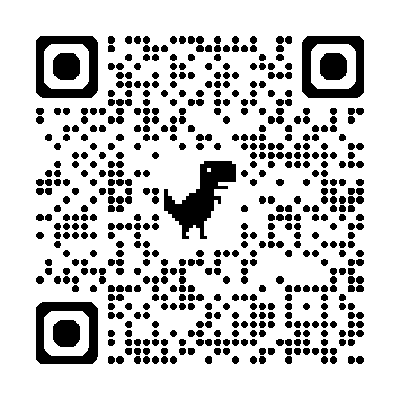
Challenge Sign-up
Notes:
Must sign up by February meeting!

Slide 8
Name the
Challenge
Notes:
Include your ideas in the chat

Slide 9
Our Issue: The Wig Coverage Bill
What it does:
  Asks for Medicare coverage for medical wigs (cranial prostheses)
Goal:
  Expand wig access to as many community members as possible
Notes:
This important legislation ensures that people with alopecia areata on Medicare can afford the wigs they medically need.
This is a critical step to improve the quality of life and advance well-being of people with alopecia areata.
In a survey, nearly 90% of people with alopecia areata reported that wigs had a positive influence on their mental health.
15% to 20% of those surveyed had never worn a wig due to the unaffordable financial cost.
High-quality medical wigs can cost thousands of dollars, making them unaffordable for many patients, particularly individuals in the Medicare program.
This legislation will be introduced into the House and Senate soon.

Slide 10
Admin
Please complete your questionnaires ASAP!
February meeting:
  Legislator meeting training
  Building a Fellows community
Miss a meeting? Help and feedback will always be available
  Email Abby and/or Julie
  Office hours with Abby: Sunday, Feb. 1, 7PM EST/4PM PST
Notes:
For February meeting:
Culture-building activities could include lots of different things: superlatives, yearbook, etc.
Training: How to crush your legislator meetings
We understand you might have to miss a meeting. You can easily catch up by watching the recording, reaching out to Abby or Julie, or visiting Abby's office hours. Abby will host office hours where you can ask questions, share ideas, and hang out to meet members of the TAF community. We will send out a link in a follow-up email.

